Slide 2
Is the ASQ :SE-2 Screener the behavioral or the developmental screener?
What tool/app must we use to ensure we are conducting the correct questionnaire with parent?
If the child scored (above cutoff) in black area, what needs to be done next?
If the child scored (close to cutoff) in gray area, what needs to be done next?
If the child scored (close to cutoff) in gray area, but closer to black area, what needs to be done next?
If the child scored (below cutoff) in the white area, should you still open a ASQ:SE-2 goal?
If the child scores (below cutoff) in the white area BUT parent has a concern in child’s behavior, what needs to be done next?
If a referral needs to be submitted, what referral forms will you submit?
If a referral needs to be done, who are you submitting the referral to?
If there is a concern but parent would like more time, does the teacher still need to submit a referral?

Slide 3
Why do we screen?
Social emotional problems in young children often go undetected.
Without support and services, social emotional problems can lead to school problems/failure, unemployment and other adult problems

Slide 4
ASQ:SE-2 (2015)
Developed as a complement to the ASQ-3 questionnaire; behavioral screener to identify social emotional delays or disorders
30 questions that can be used to identify children from 1-72 months old
Available in English and Spanish
Written at a 4th grade level
Screens for 7 domains:
Self regulation, compliance, communication, adaptive functioning, autonomy, affect and interactions with others

Slide 5
ASQ:SE-2 Age Intervals questionnaires
2 month used for 1 – 3 months
6 month used for 3 – 9 months
12 month used for 9 – 15 months
18 month used for 15 – 21 months
24 month used for 21 – 27 months
30 month used for 27 – 33 months
36 month used for 33 – 42 months
48 month used for 42 – 52 months
60 month used for 54 – 72 months
ASQ Calculator Site- Ages and Stages (asqagecalculator.com)

Slide 6
Head Start Performance Standards
1302.33 Child Screenings and Assessments
(A) Screening
1. In collaboration with each child’s parent and with parental consent, a program must complete or obtain a current developmental screening to identify concerns regarding a child’s developmental, behavioral, motor, language, social, cognitive, and emotional skills within the 45 calendar days of when the child first attends the program or, the first home based program option, receives a home visit.

Slide 7
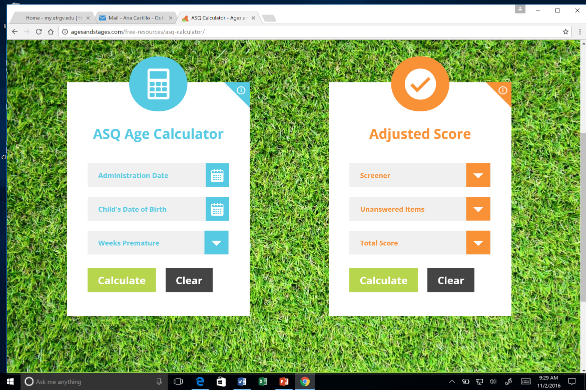
MUST DO’S
Use ASQ Age Calculator: http://agesandstages.com/free-resources/asq-calculator/
Complete the entire questionnaire out which means:
No blanks
Must transfer ALL answers/ responses into the Information Summary Report
Summary report must be filled out completely.
Follow through with the “Follow Up Action Taken” section on Summary Report.
If you are providing strategies, you MUST follow through and open a goal on your Child Development Plan.
*ASK parent if child was born premature (upon scheduling Home Visits)
*If yes, child’s age will need to be adjusted using ASQ calculator.

Slide 8
Administering the ASQ:SE-2
1. Have the parent with teacher support complete the questionnaire – provide reading or translation assistance as needed
Each questionnaire has ~30 simple worded questions and a few open-ended questions 1-5 questions
Parents will answer “often or always” “sometimes” or “rarely or never”
2. Score the questionnaire
Use simple scoring key, then add up the items to create total score
Compare total score to the cutoff score on Information Summary page to determine risk level.
3. Share the results with parents
Scores falling above empirically-derived cutoff points mean the child should be referred for further assessment

Slide 9
Step 1: Have the parent with teacher support complete the questionnaire
Check for comfort with language and provide reading/interpretation assistance, as necessary.
The ASQ:SE-2 questionnaire usually takes 10-15 minutes
Be sure the correct age interval questionnaire is being used
ASQ:SE-2 can be completed face-to-face, or over the phone

Slide 10
Step 2: Score the Questionnaire
Each response is coded as:
X = 10 points, v = 5, z = 0
Items of concern are marked and indicate 5 points
Be sure to double check scoring as letters can be reversed from the above item

Slide 11
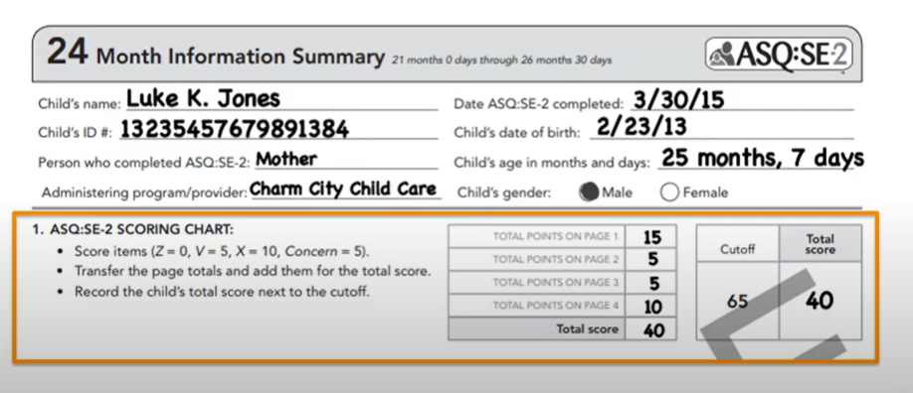
Step 2 continued
Add up the scores at the bottom of each page.
Go to the Information Summary page and add up the sum scores to create a total score

Slide 12
Compare total score to the cutoff points on the Information Summary page to determine level of risk
No or low risk - White
Monitor - Gray
Refer - Black
Scoring can take anywhere from 1-5 minutes

Slide 13
Step 3: Share the Results with parents
Interpret and discuss result findings with parent
Determine follow-up actions, if needed.
Make sure parents know that a screen that requires a referral is not the same thing as a diagnosis!!!
Low risk is a negative screen - White
Monitor is a borderline screen which should be monitored – Gray; Should be rescreened in 30-45 days.
As needed resources need to be provided to families for issues or concerns. Should be rescreened in.
Refer is a positive screen and need a referral to a designated specialist

Slide 14
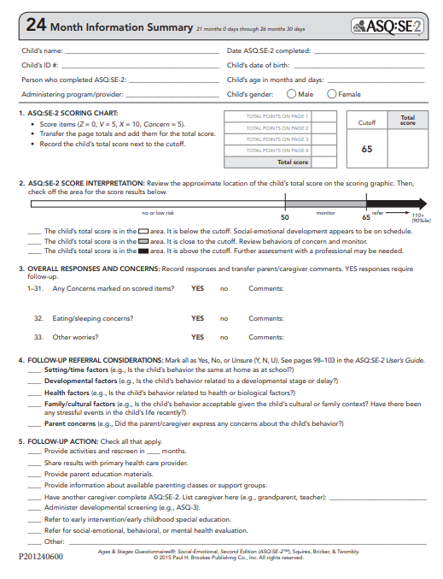
Fill out ENTIRELY THE Information Summary Report
TOP SECTION
Child’s name/ Baby ID = Child Plus ID
Date of ASQ? Day parents completes
Date of Birth
Administering program
Child gender
Section 1
Write scores
Section 2
Check off the area where the child scores
Section 3
OVERALL responses and concerns #1-30
Answer additional questions
Section 4
Label referral considerations Y (for Yes), N (for No) and U (for Unsure)
Section 5
MUST check off what is the follow up action for the results of ASQ. DO NOT LEAVE BLANK.

Slide 15
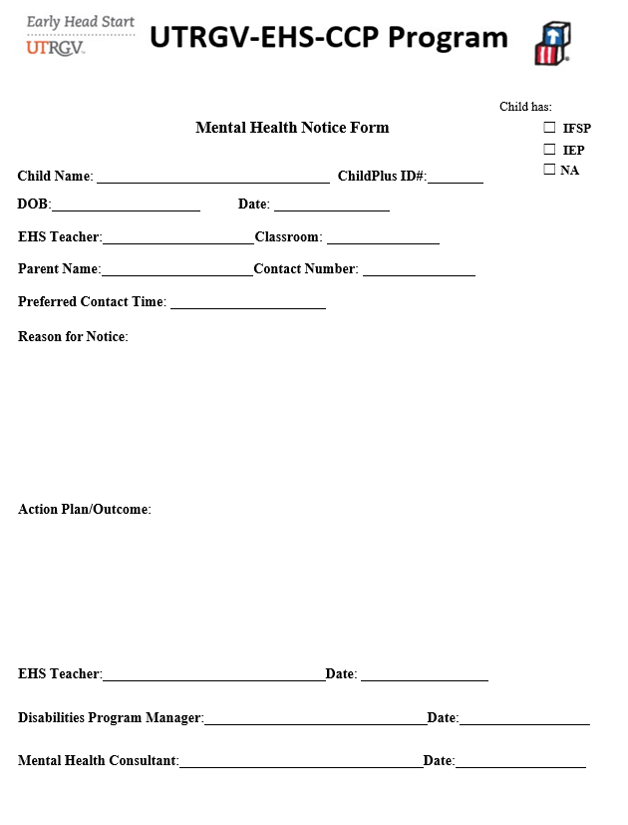
Fill out IN HOUSE Referral Form

Slide 16
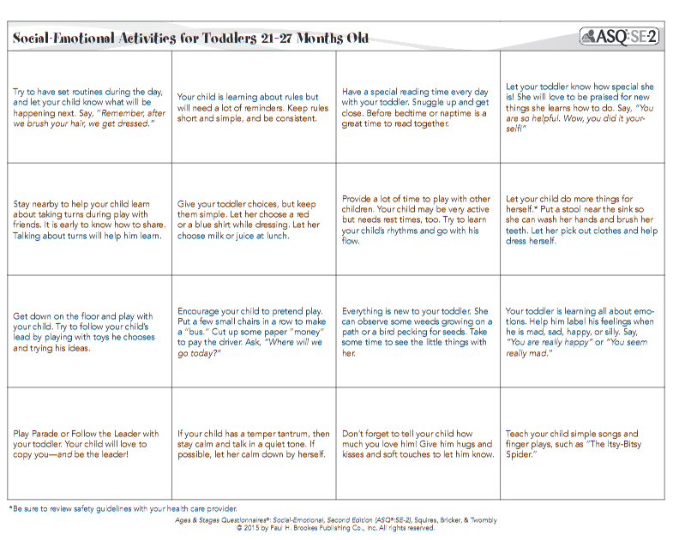
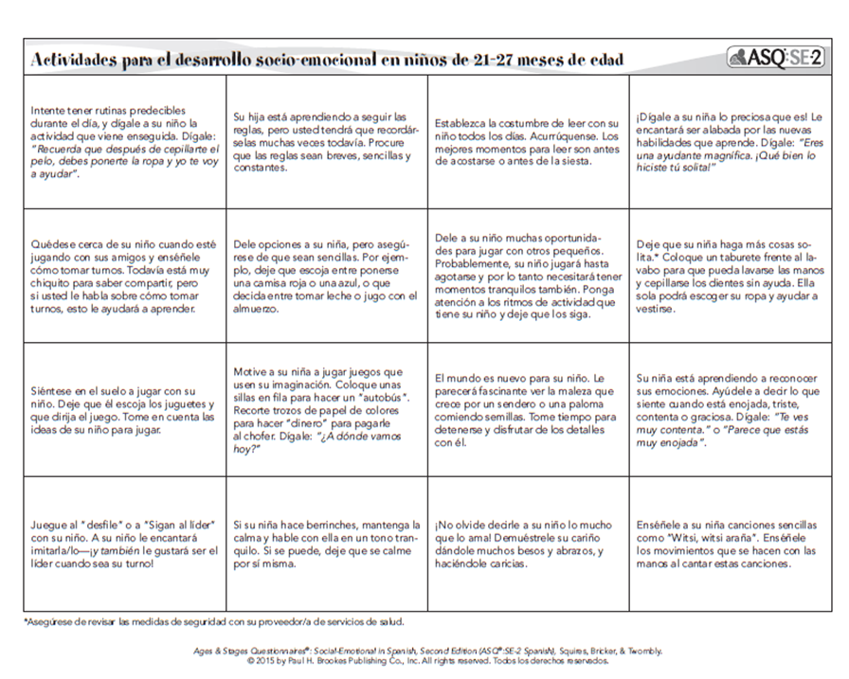
ASQ:SE-2 STRATEGIES
Goals can be opened even if child passed screener.
Use your school readiness goals to align your ASQ:SE-2 strategies with the appropriate domain
Strategies are available in English and Spanish
ASQ:SE-2 strategies in English and Spanish will be available on the website www.ehsflexpd.com under “Education” labeled “ASQ:SE-2

Slide 17
1. ASQ:SE-2 MUST BE COMPLETED Within 45 calendar days of when the child first attends the program/ Teacher is responsible for tracking the 45day deadline.
2. Legal guardian answers ASQ’s via conference with teacher
3. Teacher reviews ASQ’s. Any questions and/or concerns with the completion of the ASQ’s will be discussed and clarified during home visit.
After teacher revises the ASQ:SE-2 PROCEED to do the following:
4. If child scores in monitor area (gray), teacher will note down on sheet of paper or notebook for keepsake and provide activities using the asq:SE-2 strategies and open Individualization based on scores.
5. If Child scores in area of concern (black) or there is a parent concern, teacher will note and complete an in-house referral form and submit to center manager/site director/Mental Health Consultant, Disabilities Program Manager, MENTOR Coaches, Health Coordinator and Family Service Coordinator via email.

Slide 18
Jose Flores DOB: 8-6-2019
Not born prematurely

Slide 19
Is the ASQ :SE-2 Screener the behavioral or the developmental screener?
What tool/app must we use to ensure we are conducting the correct questionnaire with parent?
If the child scored (above cutoff) in black area, what needs to be done next?
If the child scored (close to cutoff) in gray area, what needs to be done next?
If the child scored (close to cutoff) in gray area, but closer to black area, what needs to be done next?
If the child scored (below cutoff) in the white area, should you still open a ASQ:SE-2 goal?
If the child scores (below cutoff) in the white area BUT parent has a concern in child’s behavior, what needs to be done next?
If a referral needs to be submitted, what referral forms will you submit?
If a referral needs to be done, who are you submitting the referral to?
If there is a concern but parent would like more time, does the teacher still need to submit a referral?

Slide 20
Answers
1. Behavioral screener
2. ASQ Calculator
3. Mental Health Notice Form should be done by teacher and provide strategies to parent.
4. Provide strategies to parent, open an ASQ:SE-2 goal and monitor the child.
5. Mental Health Notice Form should be done by teacher and provide strategies to parent.
6. Yes, there is always room for improvement.
7. Mental Health Notice Form should be completed by teacher.
8. Mental Health Notice Form
9. Center Manager/Site Director, Mental Health Consultant, Disabilities Program Manager, Coaches,, Health Coordinator and Family Service Coordinator.
10. Yes, fill out the Mental Health Notice Form to inform the Mental Health Consultant.

Slide 21
Conclusion
Regardless of the outcome, sharing screening results provides a great opportunity to promote developmental monitoring
Daily brain building activities for parents to do w/ children
CDC developed the Free milestones tracker to help parents monitor their children’s developmental milestones by providing checklists

